Slide 1
KLK2 Target Evaluation
Confidential 1

Slide 2
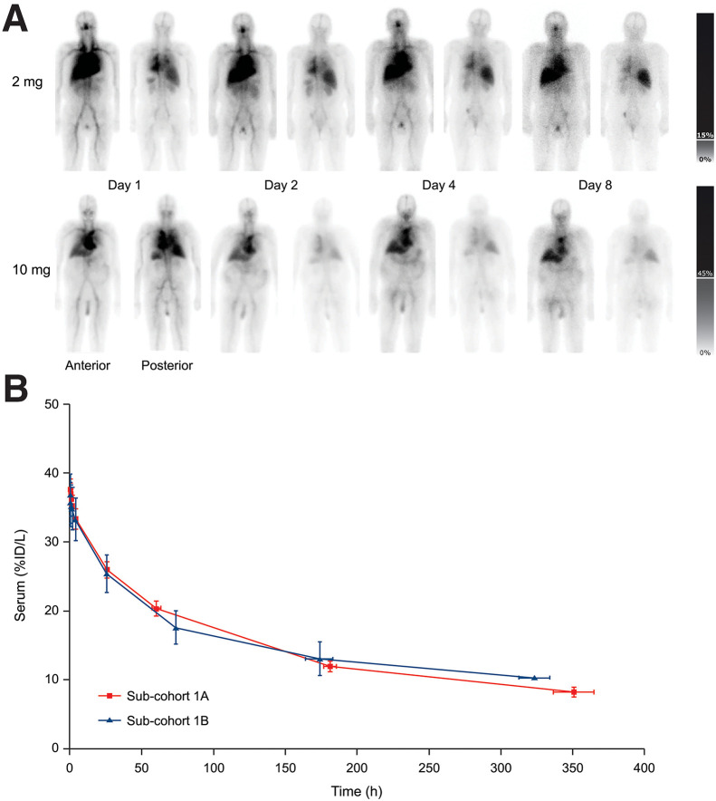
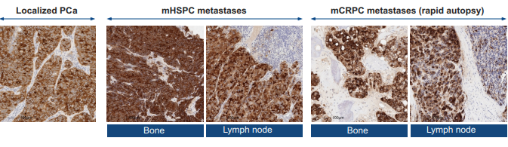
Prostate: KLK2 positivity across stages & risk levels creates broad RLT opportunity
Target Selection
Expression
Biology & Feasibility
KLK2 is more homogeneously and consistently over expressed than PSMA
Tumor-specific accessibility | ✓ | Tumor specific expression
Internalization | x | Select for peptides that induce internalization, similar to Abs
Secretion | ✓ | Secreted at very low levels
Ligandability | ✓ | Known active site & small molecule ligands
Overexpressed in 85% prostate cancers overall
More homogenously expressed in LPC, mHSPC vs. PSMA
Maintained across stages & metastases
More frequently overexpressed in Bone, Lymph mets vs. PSMA
2mg
Landscape
One competing KLK2 RIT JNJ-6420, currently in Ph 1
Liability: Suffers from serious, modality based DLT (see left)
¹¹¹In-DOTA-h11B6 antibody planar imaging showed tumor uptake with little target mediated uptake in healthy tissues
However, JNJ reported 2 Grade 5 adverse events of ILD for ²²⁵Ac-DOTA-h11B6 RIT, likely due to mAb accumulation – not a liability for peptide RLT
Sego’s Approach
Modality | KLK2 targeted monomeric or bis-peptide RLT
Positioning | Initial positioning in mCPRC, with intent to expand beyond late-stage patients
10mg
anterior
posterior
Sources: Pandit-Taskar et al. J Nucl Med. 2024 , JNJ ASCO 2024 NCT04644770, Shen et al, Clin. Cancer. Res 2025

Slide 3
Summary: KLK2 is a highly-prostate specific & commonly overexpressed target
Biology
KLK2 (human kallikrein-2, hK2) is an androgen-regulated serine protease closely related to PSA (KLK3) that activates pro-PSA and contributes to seminal fluid proteolysis. It exists as both a secreted enzyme and pro-hK2, detectable in serum and tumor tissue, and has recently been shown to be retained at the tumor cell surface, making it accessible as a therapeutic target.
Highly prostate-specific and overexpressed in ~85% of prostate cancers, with lower normal-tissue expression than PSMA and minimal relevance of normal prostate expression following standard therapy. Expression of KLK2 is maintained across disease stages (LPC, mCSPC, mCRPC) and in metastases. Importantly, KLK2 increases with AR reactivation, while PSMA often declines, positioning KLK2 as a compelling target in PSMA-negative, resistant disease and beyond.
KLK2 has been clinically validated through antibody-based RLT and bispecific antibody programs, confirming target accessibility. However, antibody formats show limitations in therapeutic window, creating an opportunity for peptide-based RLT with improved tumor uptake, dosimetry and safety profile
With ~40–50% of mCRPC patients failing or ineligible for PSMA-RLT, there is a clear unmet need. Current competition includes a Phase 1 antibody-RLT with dose-limiting toxicities and a KLK2×CD3 bispecific in Phase 3, leaving a differentiated opportunity for a peptide-based KLK2 RLT to expand beyond the ~$2B PSMA-RLT market.
Expression
Feasibility
Landscape
Sego’s Opportunity
Design a Best in Class, peptide-based RLT that has stronger efficacy against KLK2, a target that is consistently & selectively overexpressed in majority of PCa
Confidential 3

Slide 4
Expression
KLK2 expression is strong across all stages of prostate cancer
Sources: Human Protein Atlas, Shen et al, Clin. Cancer. Res 2025, Georgiev et al Nat Biomed Eng 2025
Confidential 4

Slide 5
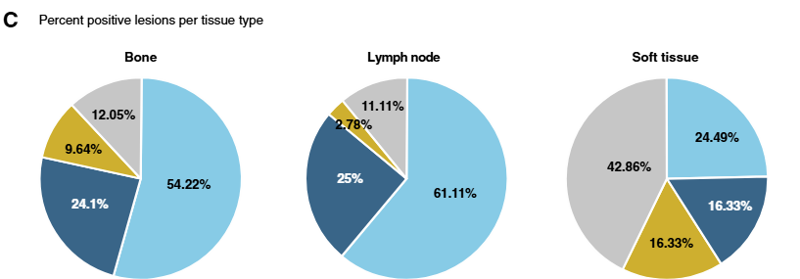
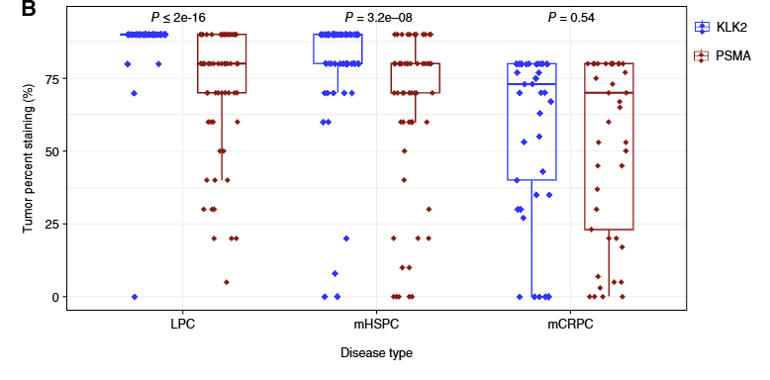
Expression
KLK2 is more homogenously expressed in earlier stages of PC and more frequently expressed in metastases compared to PSMA
KLK2 intratumoral expression is higher in earlier hormone sensitive PC vs PSMA
Bone and lymph metastases in mCPRC are more frequently positive for KLK2 vs PSMA
78% KLK2+
63% PSMA+
86% KLK2+
64% PSMA+
41% KLK2+
41% PSMA+
KLK2 + PSMA +
KLK2 – PSMA +
KLK2 + PSMA –
KLK2 – PSMA –
Sources: Shen et al. Clin Cancer Res 2025
Notes:
patients with LPC 91% (91/100), mCSPC 82% (81.98), and mCRPC 75.5%(34/45) had high tumor expression of hK2 (IHC staining intensity score = 3)
KLK2 and PSMA protein expression in different stages of prostate cancer [LPC (n ¼ 100), mHSPC (n ¼ 100), and mCRPC (n ¼ 45)] by IHC with semiquantitative pathologist reporting of the percentage of tumor showing any staining. The box refers to the IQR (25%–75% of samples), with the median shown as a horizontal line in the middle
Proportions of bone, lymph node, and soft tissue lesions showing coexpression of KLK2 and PSMA, as evaluated by mIF. The lesion is considered positive when ≥50% of cells are stained positive by mIF

Slide 6
Expression
KLK2 is expressed in prostate epithelial cells, overexpressed in prostate cancer cells, and absent in other healthy tissues
Prostate Cancer Expression
Type | Method | Criteria | Value | Source
Protein | IHC | IHC staining intensity score = 3 in tumors | patients with LPC 91% (91/100), mCSPC 82% (81.98), and mCRPC 75.5%(34/45) | Shen et al. Clin Cancer Res 2025
Protein | IHC | Positive staining weak, moderate and strong. | 77% total positive in PCa, weak in 38%, moderate in 35%, and strong in 4% of 9576 analyzable cancers. | Bonk et. al, The Prostate, 2020
mRNA | RNAseq | >1.4 fold change | KLK2 was highly expressed in PRAD compared with non-transformed tissue (5956.5 and 4175.26 transcripts per million (TPM), respectively), which comprised a >1.4-fold change. | Paniagua-Herranz et al, Int J Mol Sci 2024 (using GTEX database)
Healthy Cell Expression
Type | Method | Criteria | Value | Source
Protein | IHC | Minimal or absent staining ( <1–10%)​ | Only prostate shows high staining in 3/3 samples | Human protein atlas
mRNA | RNAseq |  | KLK2 expression in normal prostate at nTPM ~360 while all other tissues show less than 5nTPM | Human protein atlas (GTEX)
Confidential 6

Slide 7
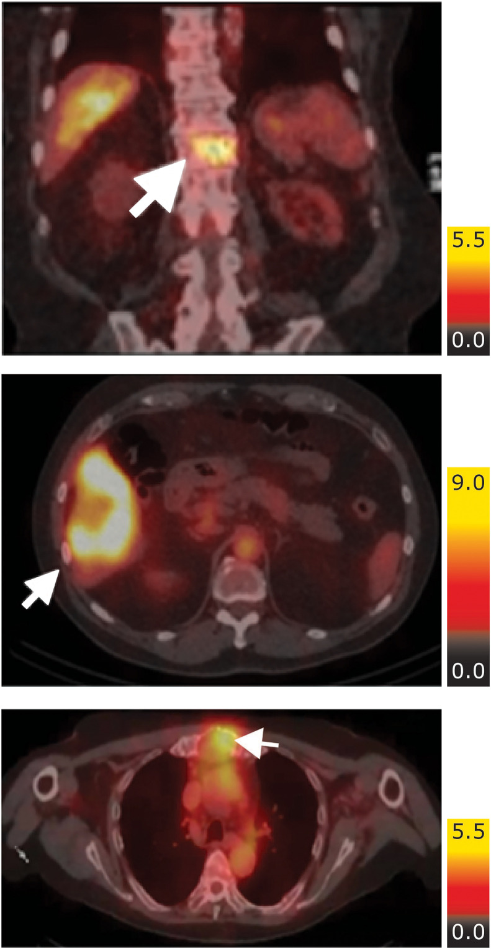
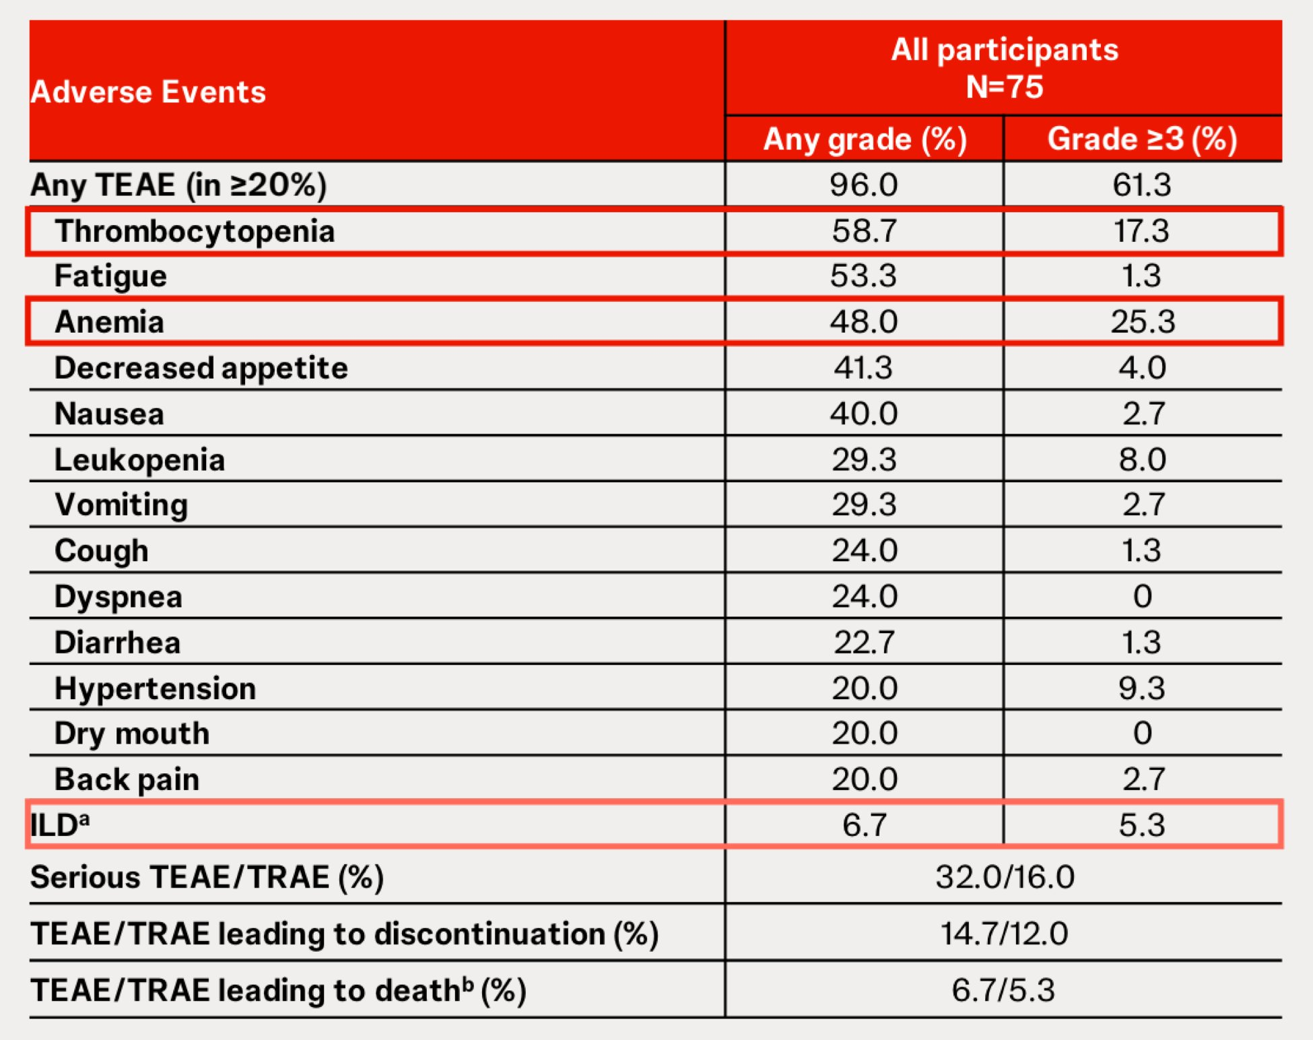
Expression
Imaging studies confirm KLK2 as a strong candidate for peptide RLT
¹¹¹In-DOTA-h11B6 antibody SPECT showed tumor uptake with little target mediated uptake in healthy tissues, unlike PSMA
However, JNJ reported two Grade 5 adverse events of ILD for ²²⁵Ac-DOTA-h11B6 RIT, likely due to mAb accumulation – not a liability for peptide RLT
Ab blood pool & liver catabolism
2mg
2mg SPECT
2mg
10mg SPECT
10mg
anterior
posterior
Arrows denote lesions
Sources: Pandit-Taskar et al. J Nucl Med. 2024 , JNJ ASCO 2024 NCT04644770
Confidential 7

Slide 8
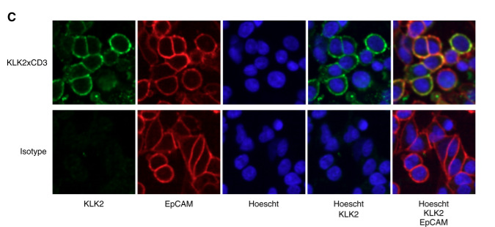
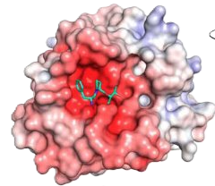
Biology
Surface location, structure and low secretion make KLK2 an appealing target
Structure & Function
Internalization
KLK2 is a serine protease closely related to PSA (KLK3) and activates pro-PSA. KLK2 cleaves seminal plasma substrates contributing to semen liquefaction
KLK2 retained at the cell surface
KLK has defined structure with known small molecule binding site
AR upregulation is known to upregulate KLK2 expression in response to the development of ARPi resistance and targeted radiotherapy
There is no evidence of native internalization. Internalization occurs with Ab binding
Our strategy will be to select for internalizing peptides
Secretion
Quantities: Median hK2 concentration in plasma 0.079 ng/ml (0.0015-16.2 ng/ml). This amount is expected to minimally affect therapeutic efficacy
Half-life: not characterized
Known small molecule binding sites
Source: 1. Shen et al. Clin Cancer Res 2025 2.McDevitt et al Nature Communications 2018 3. Vaisanen et al, Clinical Chemistry 2004 4. Structure-function analyses of human kallikrein-related peptidase 2 establish the 99-loop as master regulator of activity - PubMed, Jacob et al, Cancers 2021
Confidential 8

Slide 9
Landscape
KLK2 positivity across stages & risk levels in PCa translates to multiple clinical opportunities, from typical mCRPC to earlier lines
There are 313K new cases, 35K deaths from prostate cancer per year in the US
Localized PCa
Systemic
Biochemical recurrence (BCR)
nmHSPC
Non-metastatic hormone sensitive
nmCRPC
Non-metastatic castration resistant
mCRPC
Metastatic castration resistant
99% 5yr survival
30% recurrence rate
~30% 5yr survival
Prevalent pts | 2.5-3M | 300-600K | 100K | 60-80K | 45-60K
PSMA Positive (PET) | ~50% | ~70-80% | ~85% | ~85% | 85-90%
KLK2 Positive (IHC) | ~90% |  | ~82% |  | 75%
KLK2-RLT could capture mCRPC and earlier stages of disease, based on high tumor and low off-tumor expression profile
PSMA-RLT $2B+ sales in mCRPC alone
Sources: Seer PC statistics, 2025, Scher Plos One 2015, ACS Prostate Cancer Statistics, Gultekin et al Urol J 2020, Holzgreve et al JAMA Netw Open 2025, Hotta et al JNM 2022, Tribian et al, Diagnostics 2023, Falagario Jama Netw Open 2023, Hird et al Clin Genitourin Cancer 2023​
Confidential 9
Notes:
Notes:Intermittent ADT + KLK2 RLT
This already exists conceptually:
Intermittent ADT is accepted but underused
Its weakness is poor disease control during off-cycles
KLK2 RLT could:
Be deployed during ADT-off periods
Control AR-reactivated disease
Extend off-therapy intervals
This is a huge quality-of-life win without challenging standard of care.

Slide 10
Landscape
Example Target Product Profile for KLK2 RLT in mCRPC
Mechanism / Mode of Action | KLK2-targeted, peptide ligand conjugated to chelated ²²⁵Ac
Clinical Trial Design | Randomized, Phase 3, open-label study of KLK2-RLT to improve survival in mCPRC vs. standard of care
Indication / Target Patients | KLK2 positive, patients with metastatic, castration resistant disease
Dosing Regimen & Administration | Intravenous infusion of KLK2-RLT for 4 doses, 4 weeks apart and 2 doses every six months following initial cycle until progression
Clinical Endpoints | Primary Endpoints Radiographic progression free survival (rPFS) Overall survival (OS)
Efficacy |  | KLK2 RLT | Pluvicto
 | Dosing Schedule | 4 doses. 4 weeks apart and 2 doses every 6 months until progression | 6 doses, every 6 weeks
 | OS | 25.8mo (HR 0.95) | 24.5mo
 | rPFS | 14.1mo (HR 0.85) | 12mo
 | QOL (FACT-P) | >8mo | 7.5mo
Safety / Tolerability | Grade ≥3 TEAEs All grades dry mouth All grades anemia (Grade ≥3) All grades thrombocytopenia (Grade ≥3) | 36% <5% <27.3% <10% | 36% 59.5% 27.3% (6.2%) 10% (2%)
Confidential 10

Slide 11
Opportunity
Sego’s differentiated approach to KLK2
 | Sego’s Approaches
 | Internalized cyclic peptide | Bis-KLK2 Approach
Modality | Cyclic peptide targeting KLK2 | Peptide dimer (2x peptides for KLK2)
Isotope | ²²⁵Ac or ¹⁶¹Tb | ²²⁵Ac or ¹⁶¹Tb
Internalization | Select for internalizing peptides to utilize increased cytotoxicity with internalized alpha and auger emitters | Both internalizing and non internalizing peptides would be explored in the bis strategy
Advantage | Improved tumor retention & ability to localize isotope intracellularly. Ability to leverage more cytotoxic isotopes with internalization. | Improved K_{D} and tumor uptake/retention due to bis-peptide design, hypothetical better efficacy and potential lower doses required. May allow for use of lower affinity monomeric peptide.
Confidential 11

